Slide 1

Thermal Energy Networks
Friday June 6th, 2025
Matt Garlick CEM, CCP, BEMP
CEO, The GreyEdge Group
mgarlick@greyedgegroup.com

Slide 2


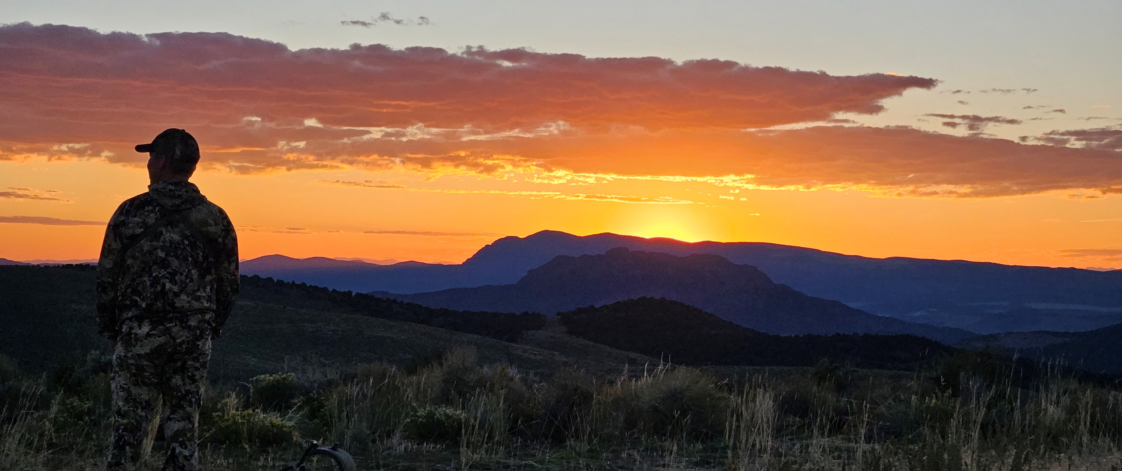
Start With Why
Notes:
We are an outdoor family, the places we love most are out in the woods and on the lake.
We live a very energy intensive lifestyle.
My greatest wish is that my kids and grandkids will be able to enjoy the same things I love and live in a similar level of comfort and security

Slide 3
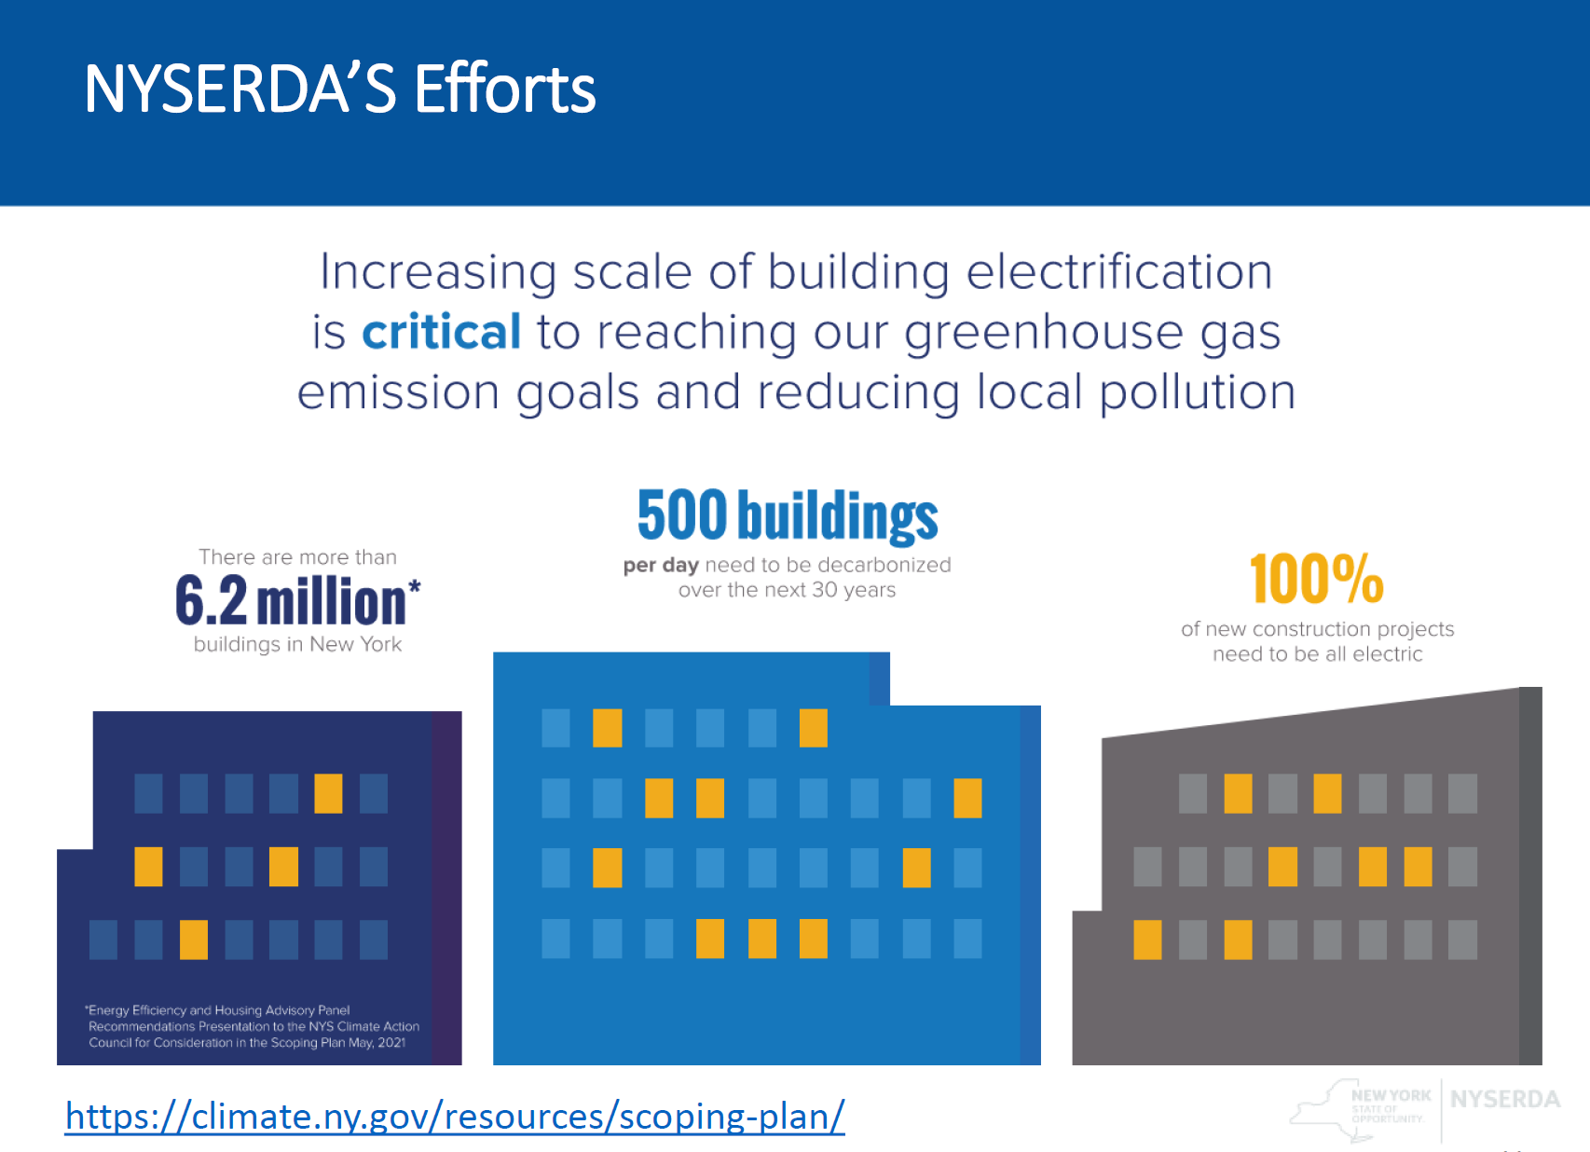
Understand the Challenge
Notes:
Energy is a precious resource- the prosperity of any society is directly correlated to how much energy they use
The conundrum is how to accommodate big energy use without having big environmental impacts

Slide 4
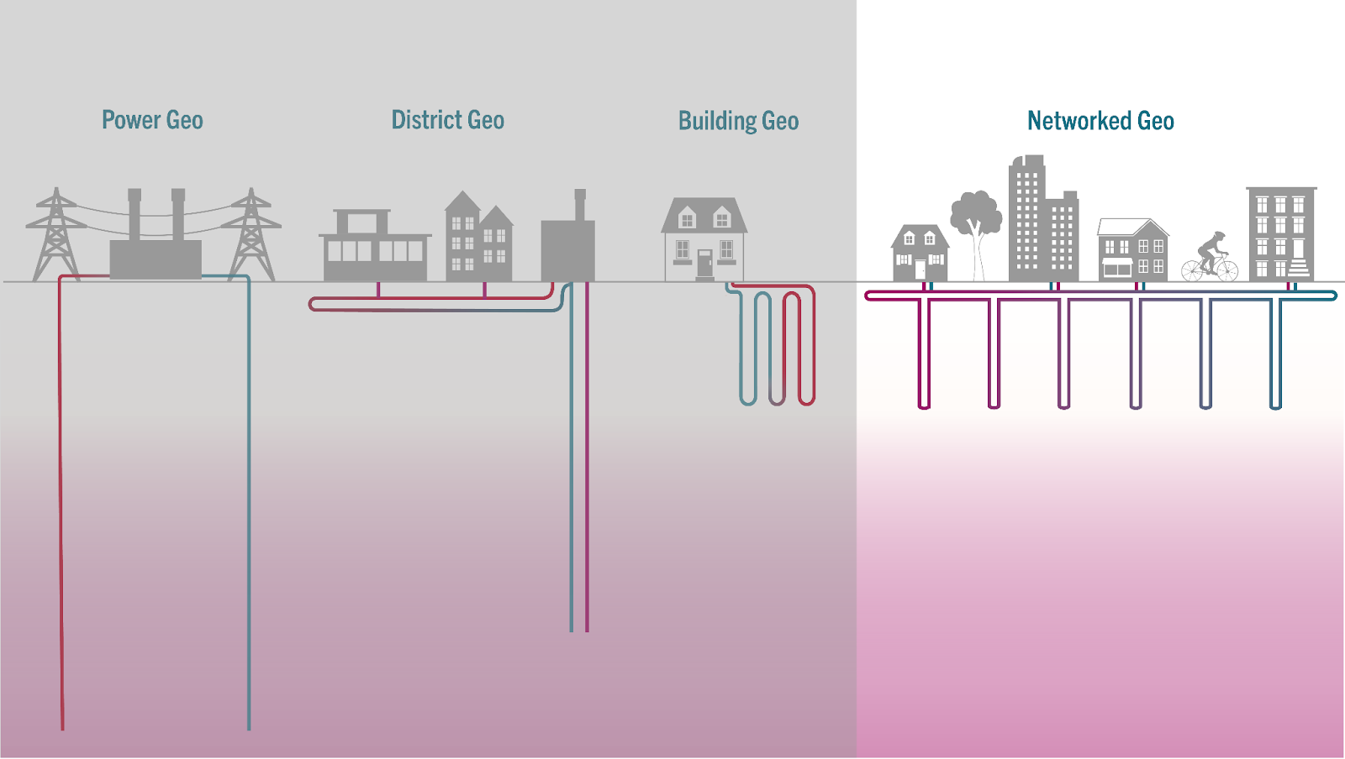
Thermal Energy Networks
Thermal Energy Networks
Image Credit: HEET

Slide 5
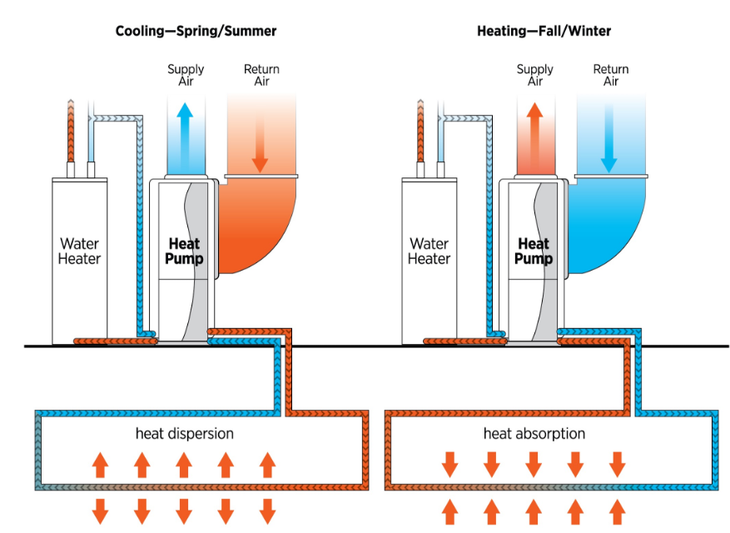
Heat Pumps
Image Credit: DOE Pathways to Commercial Liftoff: Geothermal Heating and Cooling

Slide 6
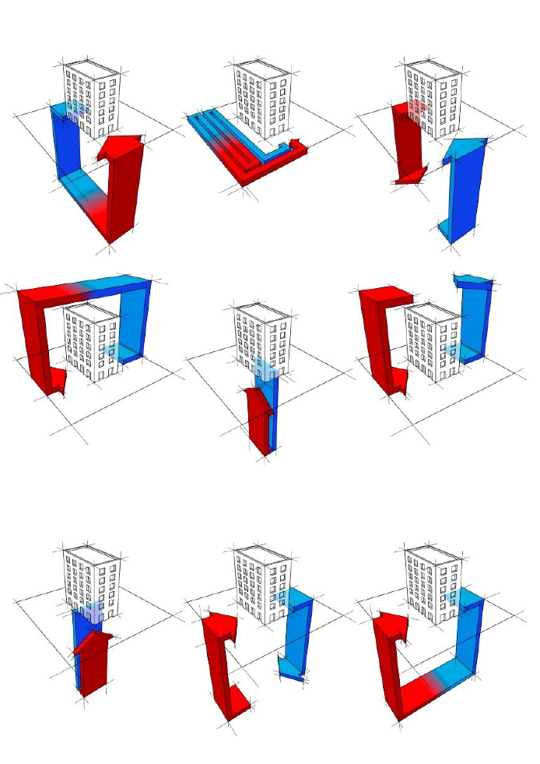
Building Level Heat Trading

Slide 7
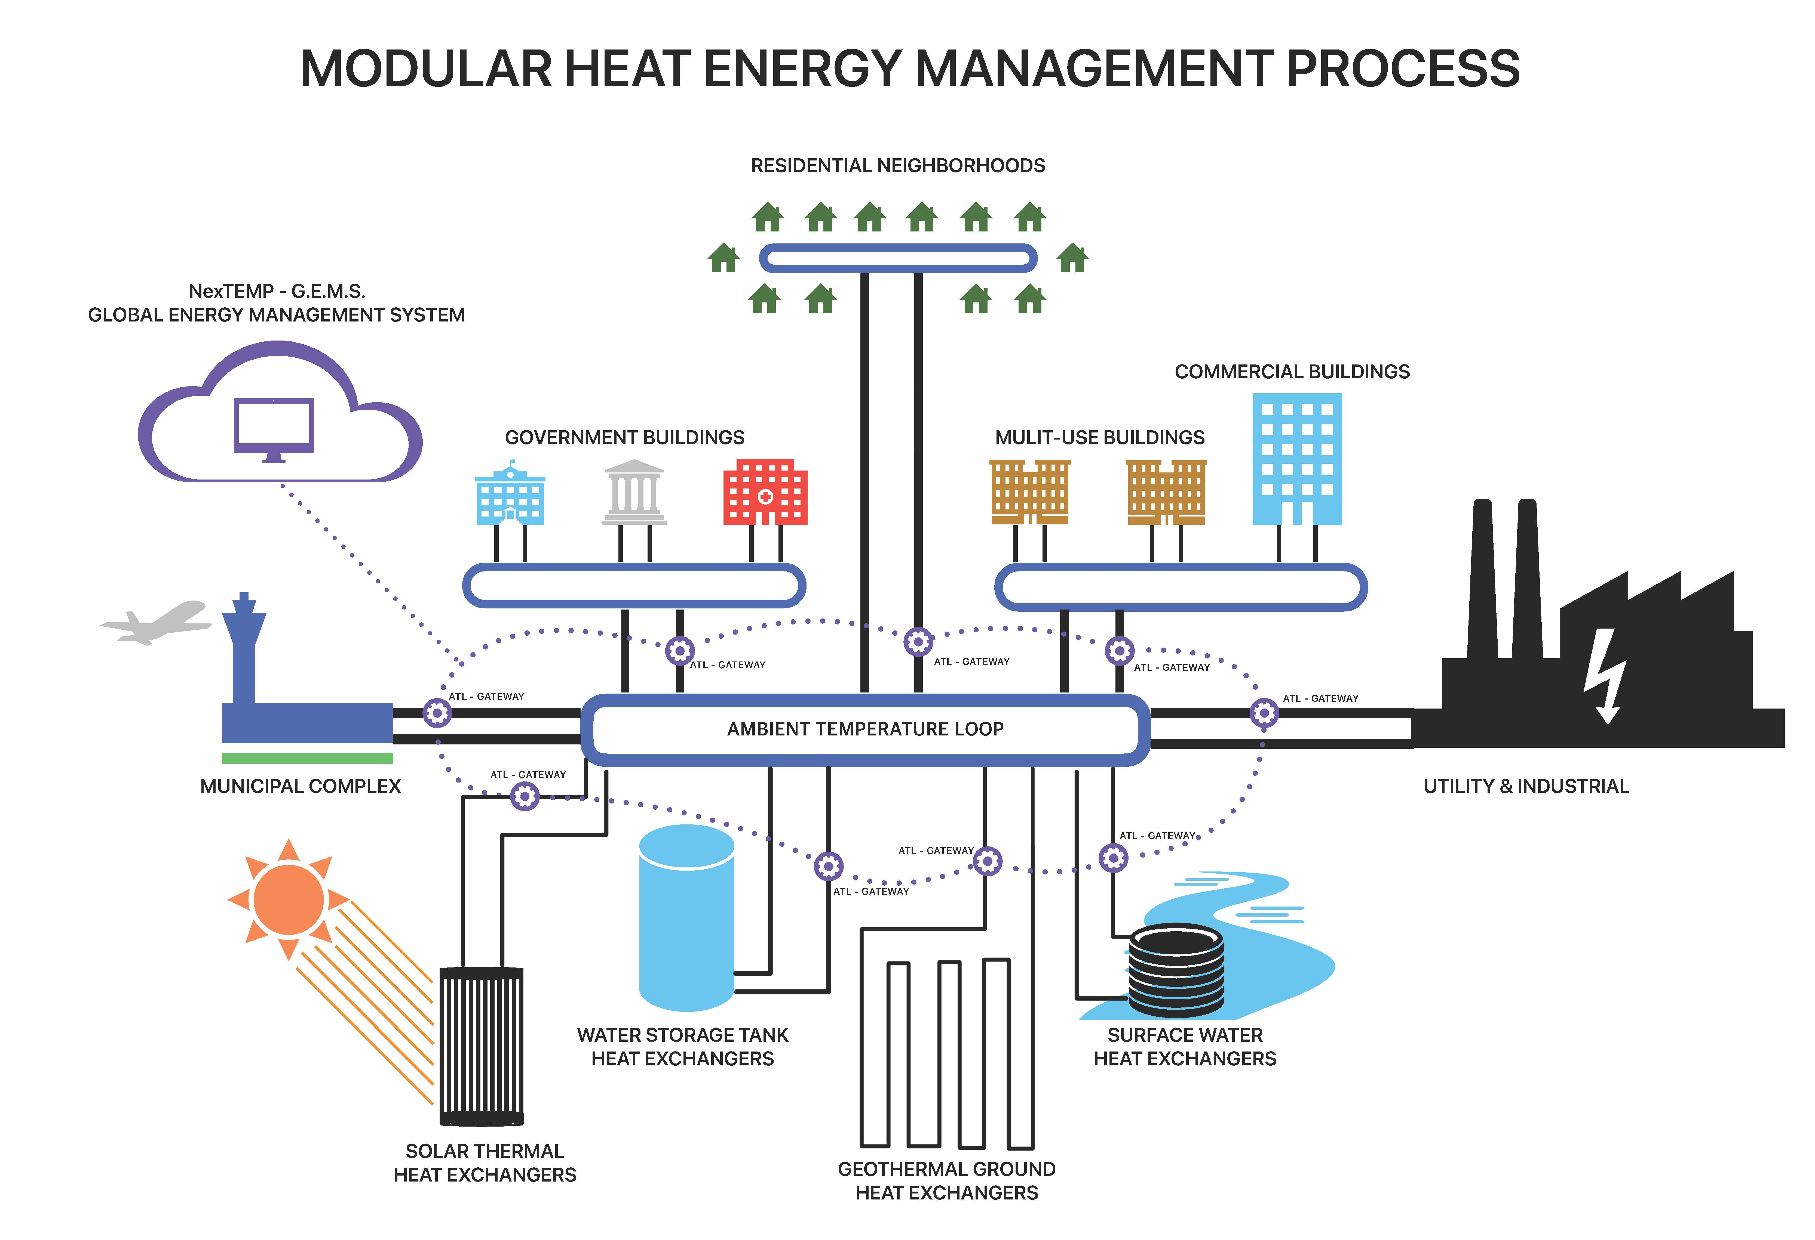

Ambient Temperature Loops (ATL)

Slide 8
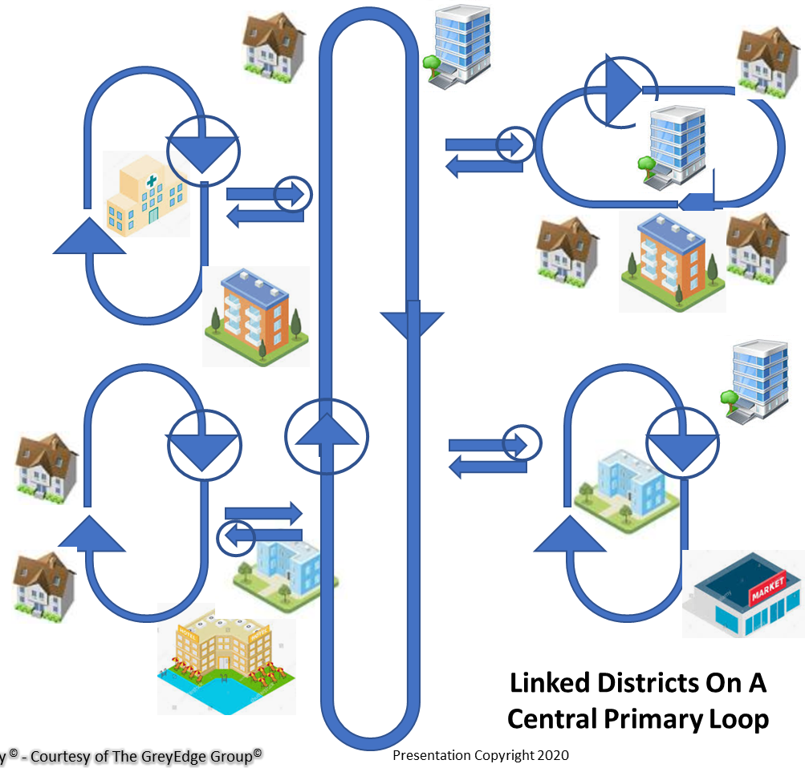
ATL MicroGrids

Slide 9
Hybrid Systems and the 50/90 Rule
Notes:
87% in this case for a network in Canada

Slide 10
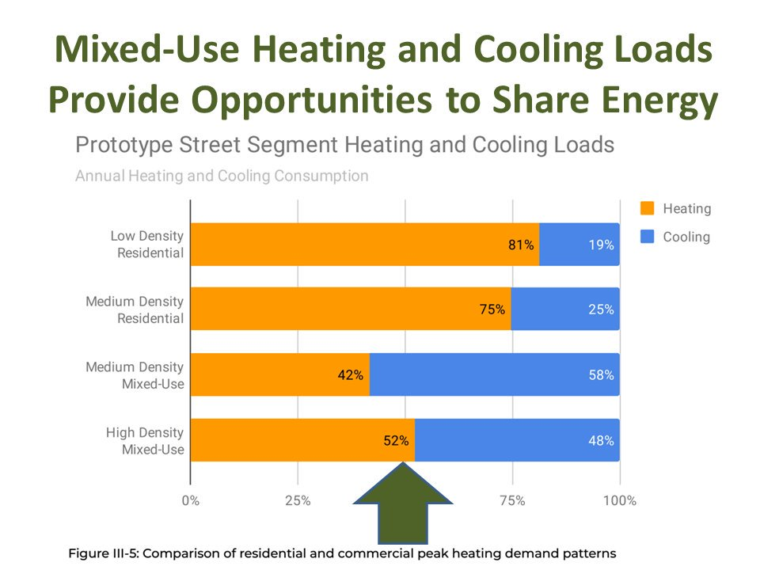
Load Diversity
Image Credit: burohappold.com

Slide 11
The Paradigm Shift
Thermal Energy Networks are Awesome!
The most efficient heating and cooling system available
An effective demand response tool
Converts thermal liabilities into assets
Modular and expandable by nature
Mature and ready to be deployed

